Slide 1
Chapter 4
Perceiving Persons

Slide 2
Observation
People evaluate faces quickly, spontaneously, and unconsciously
We infer personal characteristics from the face.
  People read traits from faces, as well as read traits into faces, based on prior information.
  People judge “baby-faced” adults differently than “mature-faced” adults.
Superficial cues can also lead us to form quick impressions!

Slide 3
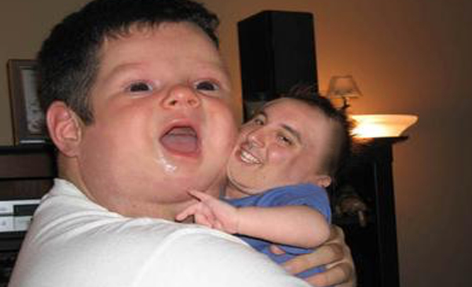
A Person’s Physical Appearance
Why do we judge “Baby-Faced” adults differently?
  Associated with helplessness traits; overgeneralized to baby-faced adults.
  People as social perceivers overgeneralize in making snap judgments.
  Humans prefer to overgeneralize rather than undergeneralize!

Slide 4
First Impressions in a Fraction of a Second
Traits Being Judged | 0.10 sec | 0.50 sec | 1 sec
Trustworthy | .73 | .66 | .74
Competent | .52 | .67 | .59
Likable | .59 | .57 | .63
Aggressive | .52 | .56 | .59
Attractive | .69 | .57 | .66
Notes:
Table 4.1 First Impressions in a Fraction of a Second Participants rated unfamiliar faces based on pictures they saw for one-tenth of a second, half a second, or a full second. Would their impressions stay the same or change with unlimited time? As measured by the correlations of these ratings with those made by observers who had no exposure time limits, the results showed that ratings were highly correlated even at the briefest exposure times. Giving participants more time did not increase these correlations.
Willis & Todorov, 2006.

Slide 5
First Impressions in a Fraction of a Second
Traits Being Judged | 0.10 sec | 0.50 sec | 1 sec
Trustworthy | .73 | .66 | .74
Competent | .52 | .67 | .59
Likable | .59 | .57 | .63
Aggressive | .52 | .56 | .59
Attractive | .69 | .57 | .66
Notes:
Table 4.1 First Impressions in a Fraction of a Second Participants rated unfamiliar faces based on pictures they saw for one-tenth of a second, half a second, or a full second. Would their impressions stay the same or change with unlimited time? As measured by the correlations of these ratings with those made by observers who had no exposure time limits, the results showed that ratings were highly correlated even at the briefest exposure times. Giving participants more time did not increase these correlations.
Willis & Todorov, 2006.

Slide 6
Perceptions of Situations
We often have “scripts” or preset notions about certain types of situations
  Enables us to anticipate the goals, behaviors, and outcomes likely to occur in a particular setting
Knowledge of social settings provides an important context for understanding other people’s verbal and nonverbal behavior.
Potential problems?

Slide 7
Perceptions of Situations
Context affects our perception of emotion
  Judgments of joy, anger, fear, pride, disgust, and surprise are quick and automatic.

Slide 8
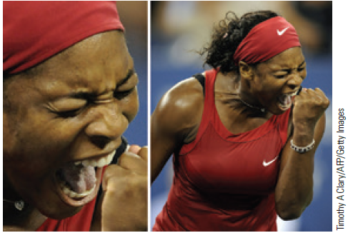
Judging Emotions in Context
Notes:
Figure 4.1 Judging Emotions in Context Look at the face of tennis star Serena Williams (left). How is she feeling—angry, perhaps, or in agony? Now look at her in a fuller context (right). You can see that Williams was actually euphoric, clenching her fist in victory at the 2008 U.S. Open.

Slide 9
Behavioral Evidence
We derive meaning from our observations by dividing the continuous stream of human behavior into discrete “units.”
  Mind perception: Process by which people attribute humanlike mental states to various animate and inanimate objects, including other people.
  Nonverbal behavior is a silent language that helps us identify a person’s inner states.

Slide 10
Nonverbal Cues
The face expresses emotion in ways that are both innate and understood by people all over the world.
  Social value of the human face
  Universal facial expressions (basic emotions!)
Other nonverbal cues
  Body language
  Eye contact or gaze
  Physical touch

Slide 11
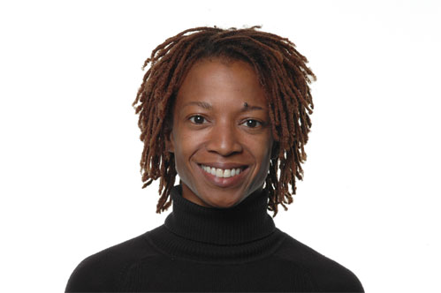
Notes:
Figure 4.2 How Good Are People at Identifying Emotions in the Face? A meta-analysis of emotion recognition studies involving 22,148 participants from 42 countries confirmed that people all over the world can recognize the six basic emotions from posed facial expressions.
Based on Elfenbein & Ambady (2002).

Slide 12
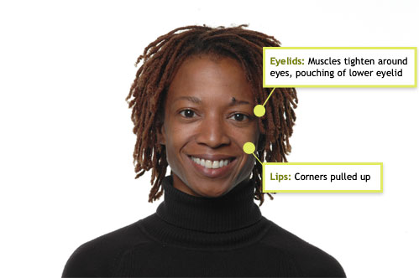
Happiness
Notes:
Figure 4.2 How Good Are People at Identifying Emotions in the Face? A meta-analysis of emotion recognition studies involving 22,148 participants from 42 countries confirmed that people all over the world can recognize the six basic emotions from posed facial expressions.
Based on Elfenbein & Ambady (2002).

Slide 13
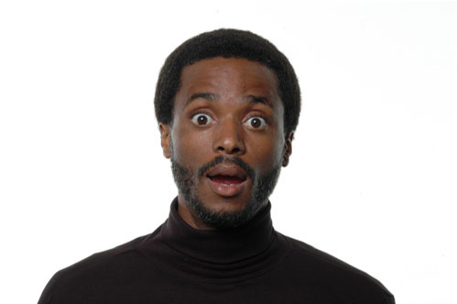
Notes:
Figure 4.2 How Good Are People at Identifying Emotions in the Face? A meta-analysis of emotion recognition studies involving 22,148 participants from 42 countries confirmed that people all over the world can recognize the six basic emotions from posed facial expressions.
Based on Elfenbein & Ambady (2002).

Slide 14
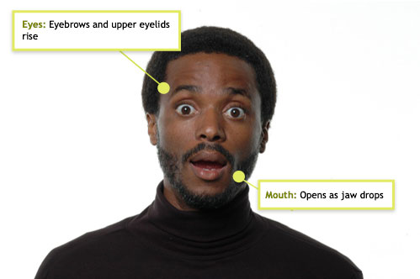
Surprise
Notes:
Figure 4.2 How Good Are People at Identifying Emotions in the Face? A meta-analysis of emotion recognition studies involving 22,148 participants from 42 countries confirmed that people all over the world can recognize the six basic emotions from posed facial expressions.
Based on Elfenbein & Ambady (2002).

Slide 15
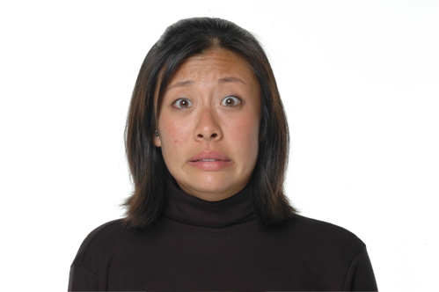
Notes:
Figure 4.2 How Good Are People at Identifying Emotions in the Face? A meta-analysis of emotion recognition studies involving 22,148 participants from 42 countries confirmed that people all over the world can recognize the six basic emotions from posed facial expressions.
Based on Elfenbein & Ambady (2002).

Slide 16
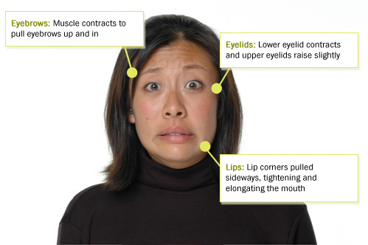
Fear
Notes:
Figure 4.2 How Good Are People at Identifying Emotions in the Face? A meta-analysis of emotion recognition studies involving 22,148 participants from 42 countries confirmed that people all over the world can recognize the six basic emotions from posed facial expressions.
Based on Elfenbein & Ambady (2002).

Slide 17
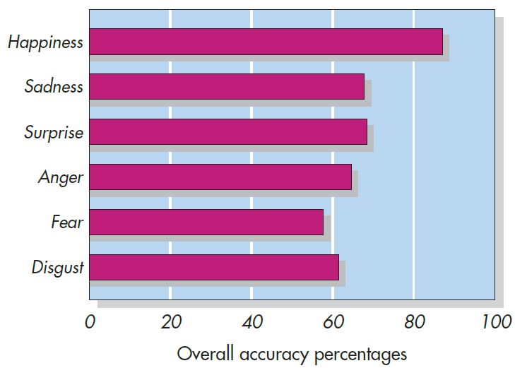
How Good Are People at Identifying Emotions in the Face?
Notes:
Figure 4.2 How Good Are People at Identifying Emotions in the Face? A meta-analysis of emotion recognition studies involving 22,148 participants from 42 countries confirmed that people all over the world can recognize the six basic emotions from posed facial expressions.
Based on Elfenbein & Ambady (2002).

Slide 18
Detecting Truth and Deception
Telling whether someone is lying?
Some channels of communication are difficult for deceivers to control, whereas others are relatively easy.
  The face can communicate emotion but is relatively easy for deceivers to control
  Nervous movements of the hands and feet also communicate emotion, but hard to control

Slide 19
Can the “Experts” Distinguish Between Truth and Deception?
Observer Groups | Accuracy Rates (%)
College students | 52.82
CIA, FBI, and military | 55.67
Police investigators | 55.79
Trial judges | 56.73
Psychiatrists | 57.61
U.S. Secret Service agents | 64.12
Keep in mind, 50/50 chance of guessing!
Notes:
Table 4.2 Can the “Experts” Distinguish Truth and Deception? Lie-detection experts with experience at making judgments of truth and deception were shown brief videotapes of 10 women telling the truth or lying about their feelings. Considering that there was a 50–50 chance of guessing correctly, the accuracy rates were remarkably low. Only a sample of U.S. Secret Service agents posted a better-than-chance performance.
From Ekman, P., and O’Sullivan, M. (1991). Who can catch a liar? American Psychologist, 46, 913–20.
Copyright © 1991 by the American Psychological Association. Reprinted by permission.

Slide 20
Why Do We Have Difficulty Detecting Deception?
Mismatch between the behavioral cues that actually signal deception and those we use to detect deception
Four channels of communication that provide potentially relevant information:
  Spoken word, the face, the body, and the voice
None of the behavioral cues people look for are very telling.

Slide 21
Dispositions
Stable characteristics
  Examples: Personality traits, attitudes, and abilities
Inferred indirectly from what a person says and does
Impressions (short term) → Dispositions (long term)

Slide 22
Attribution Theories
We observe, analyze, and explain their behavior.
  Why? At minimum we want to manage our social lives
  Making attributions
Two categories:
  Personal attributions (related to one’s character)
  Situational attributions (related to circumstance)
  Can change depending on valence, stereotypes, in-group vs. outgroup status, etc.

Slide 23
Jones’s Correspondent Inference Theory
People try to infer from an action whether the act corresponds to an enduring personal trait of the actor
  Is this a “random” event, or is telling about their personality?
Example: Was someone rude because they are an inherently rude person or was it situational?

Slide 24
Jones’s Correspondent Inference Theory
People make inferences on the basis of three factors:
  Person’s degree of choice
  Expectedness of behavior
  Intended effects or consequences of someone’s behavior
Tend to overgeneralize (more likely to assume an act reflects internal behavior)
  Especially w/ strangers!

Slide 25
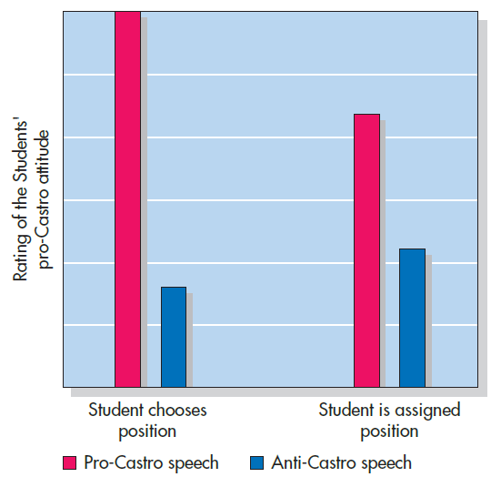
What Does This Speechwriter Really Believe? (Jones & Harris, 1967)
Notes:
Figure 4.4 What Does This Speechwriter Really Believe? As predicted by correspondent inference theory, participants who read a student’s speech (behavior) were more likely to assume that it reflected the student’s true attitude (disposition) when the position taken was freely chosen (left) rather than assigned (right). But also note the evidence for the fundamental attribution error. Even participants who thought the student had been assigned a position inferred the student’s attitude from the speech. Based on Jones & Harris (1967).

Slide 26
Attribution Biases
We are limited in our ability to process all relevant information.
We lack the kinds of training needed to employ fully the principles of attribution theory.
We often don’t bother to think carefully about the attributions we make.
Speed brings bias and perhaps even a loss of accuracy.

Slide 27
Cognitive Heuristics
Information-processing rules of thumb that enable us to think in ways that are quick and easy but that often lead to error.
Heuristic == mental shortcut!
Helpful but not perfect!
  Again can lead to overgeneralizations!
  Might rely on them too much

Slide 28
Availability Heuristic
Availability heuristic: The tendency to estimate the likelihood that an event will occur by how easily instances of it come to mind.
The availability heuristic can lead us astray in two ways:
  False-consensus effect
  Base-rate fallacy can lead to various misperception of risk.

Slide 29
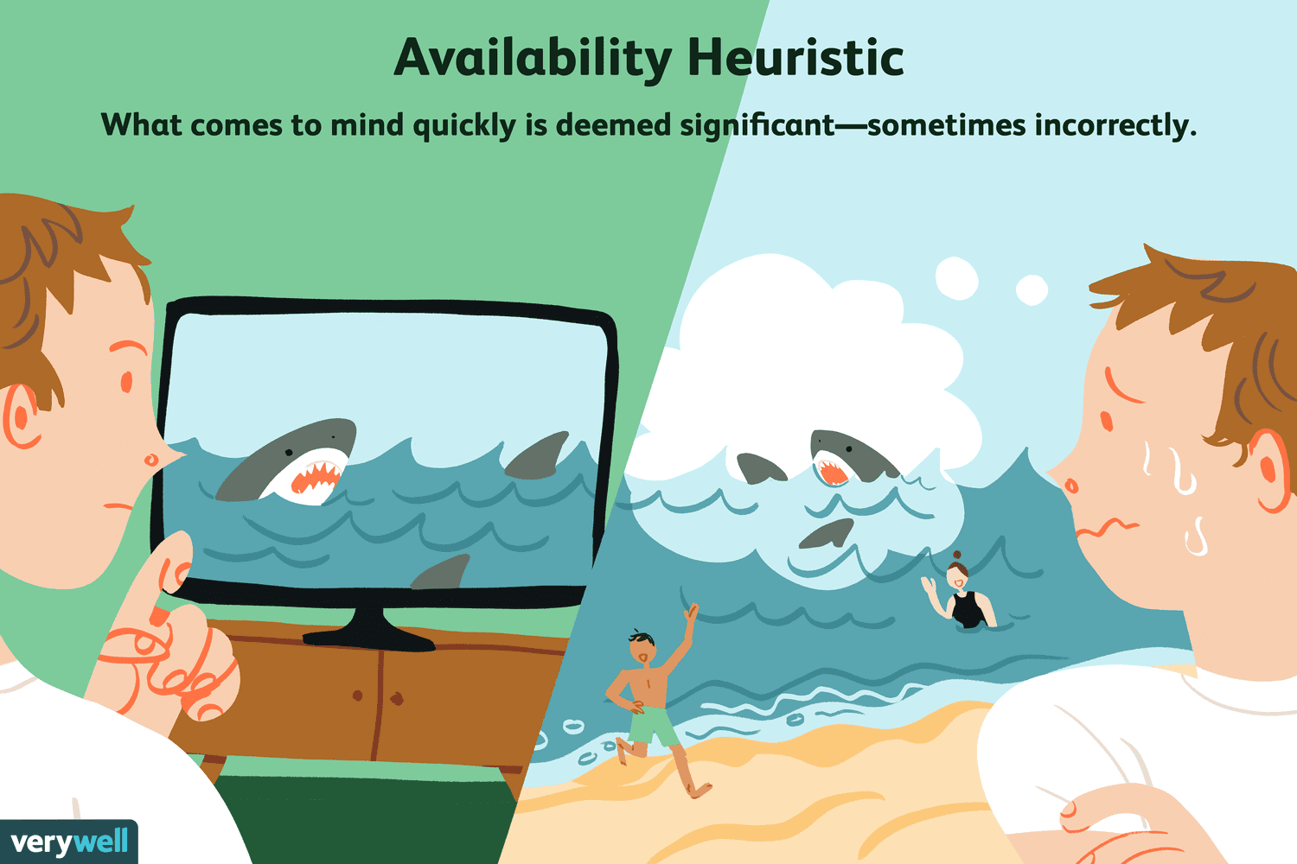

Slide 30
The False-Consensus Effect (Krueger, 2000)
Participants first rated themselves on traits, then estimated percentage of others who had the same trait
Traits | Self Yes (%) | Self No (%)
Alert | 75 | 65
Discontented | 48 | 33
Loud | 46 | 43
Meticulous | 52 | 41
Sly | 36 | 28
Smug | 41 | 33
Notes:
Table 4.3 The False-Consensus Effect In this study, participants who did and participants who did not rate various personality traits as descriptive of themselves estimated the percentage of other people who had these traits. As shown below, participants’ estimates of the population consensus were biased by their own self-perceptions.
Krueger (2000).

Slide 31
Counterfactual Thinking
A tendency to imagine alternative outcomes that might have occurred but did not.
Different types of counterfactual thoughts:
  Imagining results are better than actual results
  Imagining results are worse than actual results
Top three regrets—education, career, and romance

Slide 32
Fundamental Attribution Error
Overestimate the role of personal factors and underestimate the impact of situations
Happens even when people are fully aware of the situation’s impact on behavior!

Slide 33
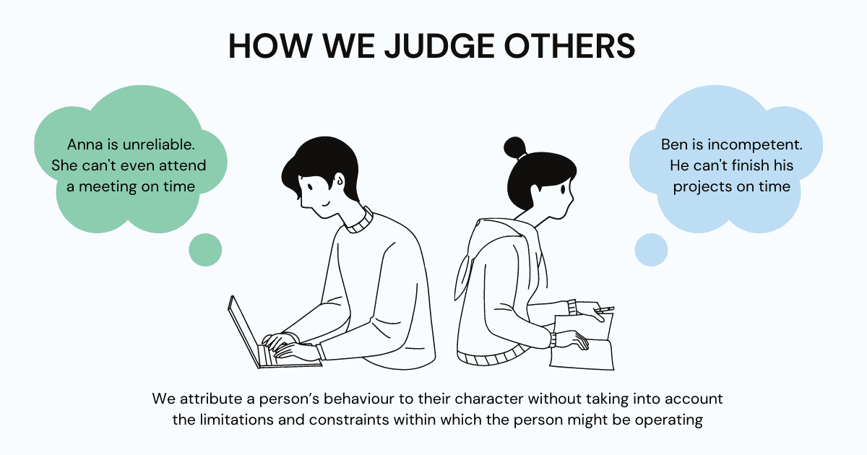

Slide 34
Culture and Attribution
Language and culture can influence the way people think about:
  Time
  Space
  Objects
  Other aspects of physical world around them
  Can also influence the way we view individuals and their place in the social world

Slide 35
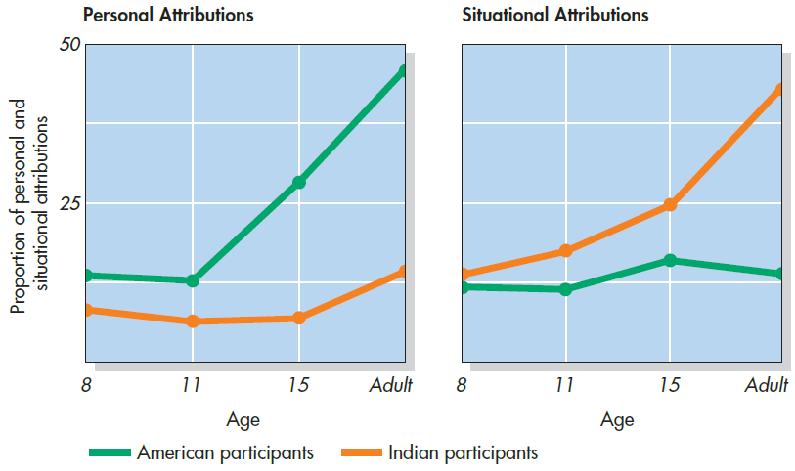
Fundamental Attribution Error: A Western Bias?
Notes:
Figure 4.6 Fundamental Attribution Error: A Western Bias? American and Asian Indian participants of varying ages described the causes of negative actions they had observed. Among young children, there were no cultural differences. With increasing age, however, Americans made more personal attributions and Indian participants made more situational attributions. Explanations for positive behaviors followed a similar pattern. This finding suggests that the fundamental error is a Western phenomenon. Based on Miller (1984).

Slide 36
Information Integration: The Arithmetic
Impression formation: The process of integrating information about a person to form a coherent impression.
How are they combined into a single coherent picture of a person?
  Summation model of impression formation or averaging model

Slide 37
Information Integration: The Arithmetic
Information integration theory—impressions formed of others based on a combination
  Personal dispositions and the current state of the perceiver
  A weighted average, not a simple average, of the target person’s characteristics.

Slide 38
Deviations from the Arithmetic
Perceiver characteristics
  Differs in terms of the kinds of impressions we form of others
  We tend to use ourselves as a standard, or frame of reference, when evaluating others.
  A perceiver’s current mood state can also influence the impressions formed of others.

Slide 39
Social Priming Effects
Priming effects:
  The tendency for recently used or perceived words or ideas to come to mind easily and influence the interpretation of new information.
  Recency bias!

Slide 40
The Priming of Social Behavior Without Awareness (Bargh et al., 1996)
Research Question: Would waiting participants interrupt a busy experimenter?
Participants given a word unscramble task
  Three groups: Neutral words, “rude” words, and “polite” words
  After completing task, ignored by the experimenter
Notes:
Figure 4.9 The Priming of Social Behavior Without Awareness Would waiting participants interrupt the busy experimenter? Compared with those who had previously been given neutral words to unscramble (center), participants given politeness words were less likely to cut in (left), and those given rudeness words were more likely to cut in (right). These results show that priming can influence not only our social judgments but our behavior as well. Based on Bargh et al. (1996).

Slide 41
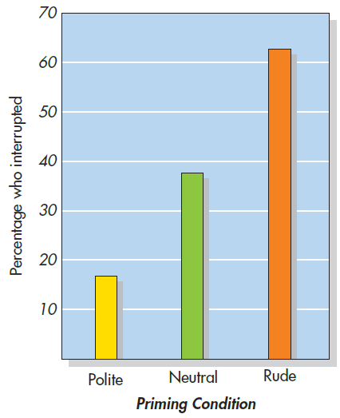
The Priming of Social Behavior Without Awareness (Bargh et al., 1996)
Notes:
Figure 4.9 The Priming of Social Behavior Without Awareness Would waiting participants interrupt the busy experimenter? Compared with those who had previously been given neutral words to unscramble (center), participants given politeness words were less likely to cut in (left), and those given rudeness words were more likely to cut in (right). These results show that priming can influence not only our social judgments but our behavior as well. Based on Bargh et al. (1996).

Slide 42
Deviations from the Arithmetic
Target characteristics:
  Across cultures, that individuals can reliably be distinguished from one another along five broad traits, or factors:
    extroversion, emotional stability, openness to experience, agreeableness, and conscientiousness
  Trait negativity bias: The tendency for negative information to weigh more heavily on our impressions than positive information

Slide 43
Perceptions of Moral Character
Accurately perceiving the moral character of others is essential for social living
“Moral” versus “warm”
  Moral: e.g., courageous, fair, principled, just, honest, trustworthy, loyal
  Warm: e.g., warm, sociable, happy, agreeable, enthusiastic, easygoing, fun, playful
People make moral judgments about others instantly and intuitively.

Slide 44
The Primacy Effect
The primacy effect: The tendency for information presented early in a sequence to have more impact on impressions than on the information presented later.
First impressions are often lasting for this reason!

Slide 45
Primacy Effect: Explanation #1
Once perceivers think they have formed an accurate impression of someone, they tend to pay less attention to subsequent information.
Evidence: When research participants read a series of statements about a person, the amount of time they spent reading each of the items declined steadily with each succeeding statement.

Slide 46
Primacy Effect: Explanation #2
Change-of-meaning hypothesis
  Once people have formed an impression, they start to interpret inconsistent information in light of that impression.
  “Acting out of character” vs. “that is actually their character”
  The meaning of a trait can be malleable.

Slide 47
Confirmation Bias
Once people make up their mind about something, they become reluctant to change their minds when confronted with new evidence.
Confirmation bias: The tendency to seek, interpret, and create information that verifies existing beliefs.

Slide 48
Perseverance of Beliefs
Events that are ambiguous enough to support contrasting interpretations are like inkblots: We see or hear in them what we expect to see or hear.
Belief perseverance: A tendency to retain to one’s initial beliefs even after they had been discredited.

Slide 49
Confirmatory Hypothesis Testing
Do we seek information objectively or are we inclined to confirm the suspicions we already hold?
  Perceivers set in motion a vicious cycle: Thinking someone has a certain trait, they engage in a one-sided search for information.
  People can be blinded by their existing beliefs.

Slide 50
The Self-Fulfilling Prophecy
Self-fulfilling prophecy: The process by which one’s expectations about a person eventually lead that person to behave in ways that confirm those expectations.

Slide 51
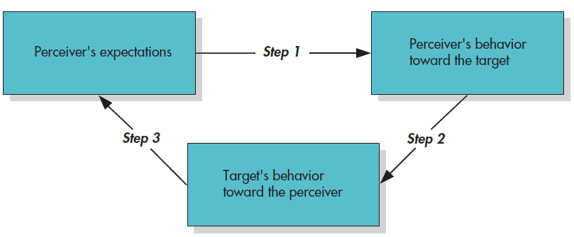
The Self-Fulfilling Prophecy as a Three-Step Process
Notes:
Figure 4.12 The Self-Fulfilling Prophecy as a Three-Step Process How do people transform their expectations into reality? (1) A perceiver has expectations of a target person; (2) the perceiver then behaves in a manner consistent with those expectations; and (3) the target unwittingly adjusts his or her behavior according to the perceiver’s actions.

Slide 52
Personality Results

Slide 53
How Accurate Are Our Impressions of Each Other?
Hard to answer!
Problems
  Often depart from the ideals of logic and often exhibit occasional bias in their social perceptions
  Often have little awareness of our limitations, leading us to feel overconfident in our judgments

Slide 54
Reasons Why We Can Be Competent Social Perceivers
The more experience people have with each other, the more accurate our judgments are.
Not good at making global judgments about others
  But… we are able to make more limited specific predictions of how others will behave in our own presence.
Lots of individual differences! Some people are just better at this than others

